Slide 1
Splunk Enterprise Setup, Monitoring & Dashboard Analysis
Prepared by: Keshav
Windows Server Environment
Date: October 2025

Slide 2
Project Objectives
1. Download and install Splunk Enterprise on Windows Server.
2. Configure Splunk to monitor host OS logs and performance data.
3. Build dashboards showing trends from monitored logs.
4. Document setup, technology used, and lessons learned.

Slide 3
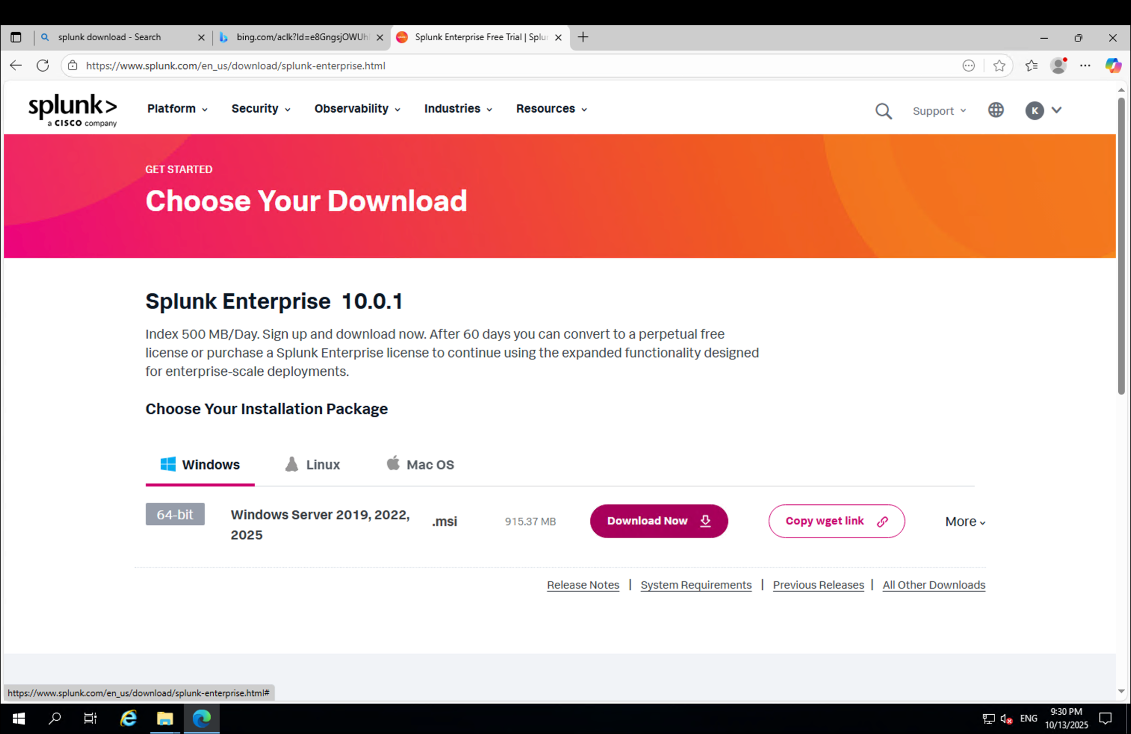

Slide 4
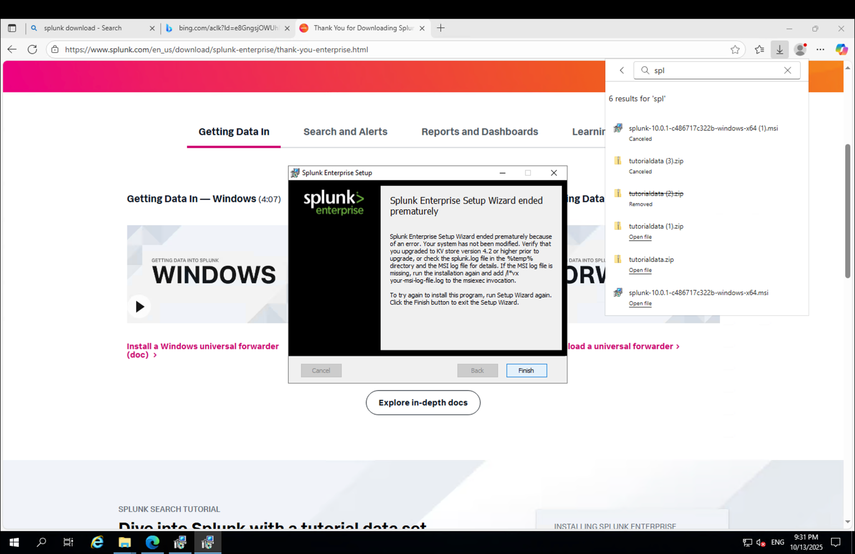

Slide 5
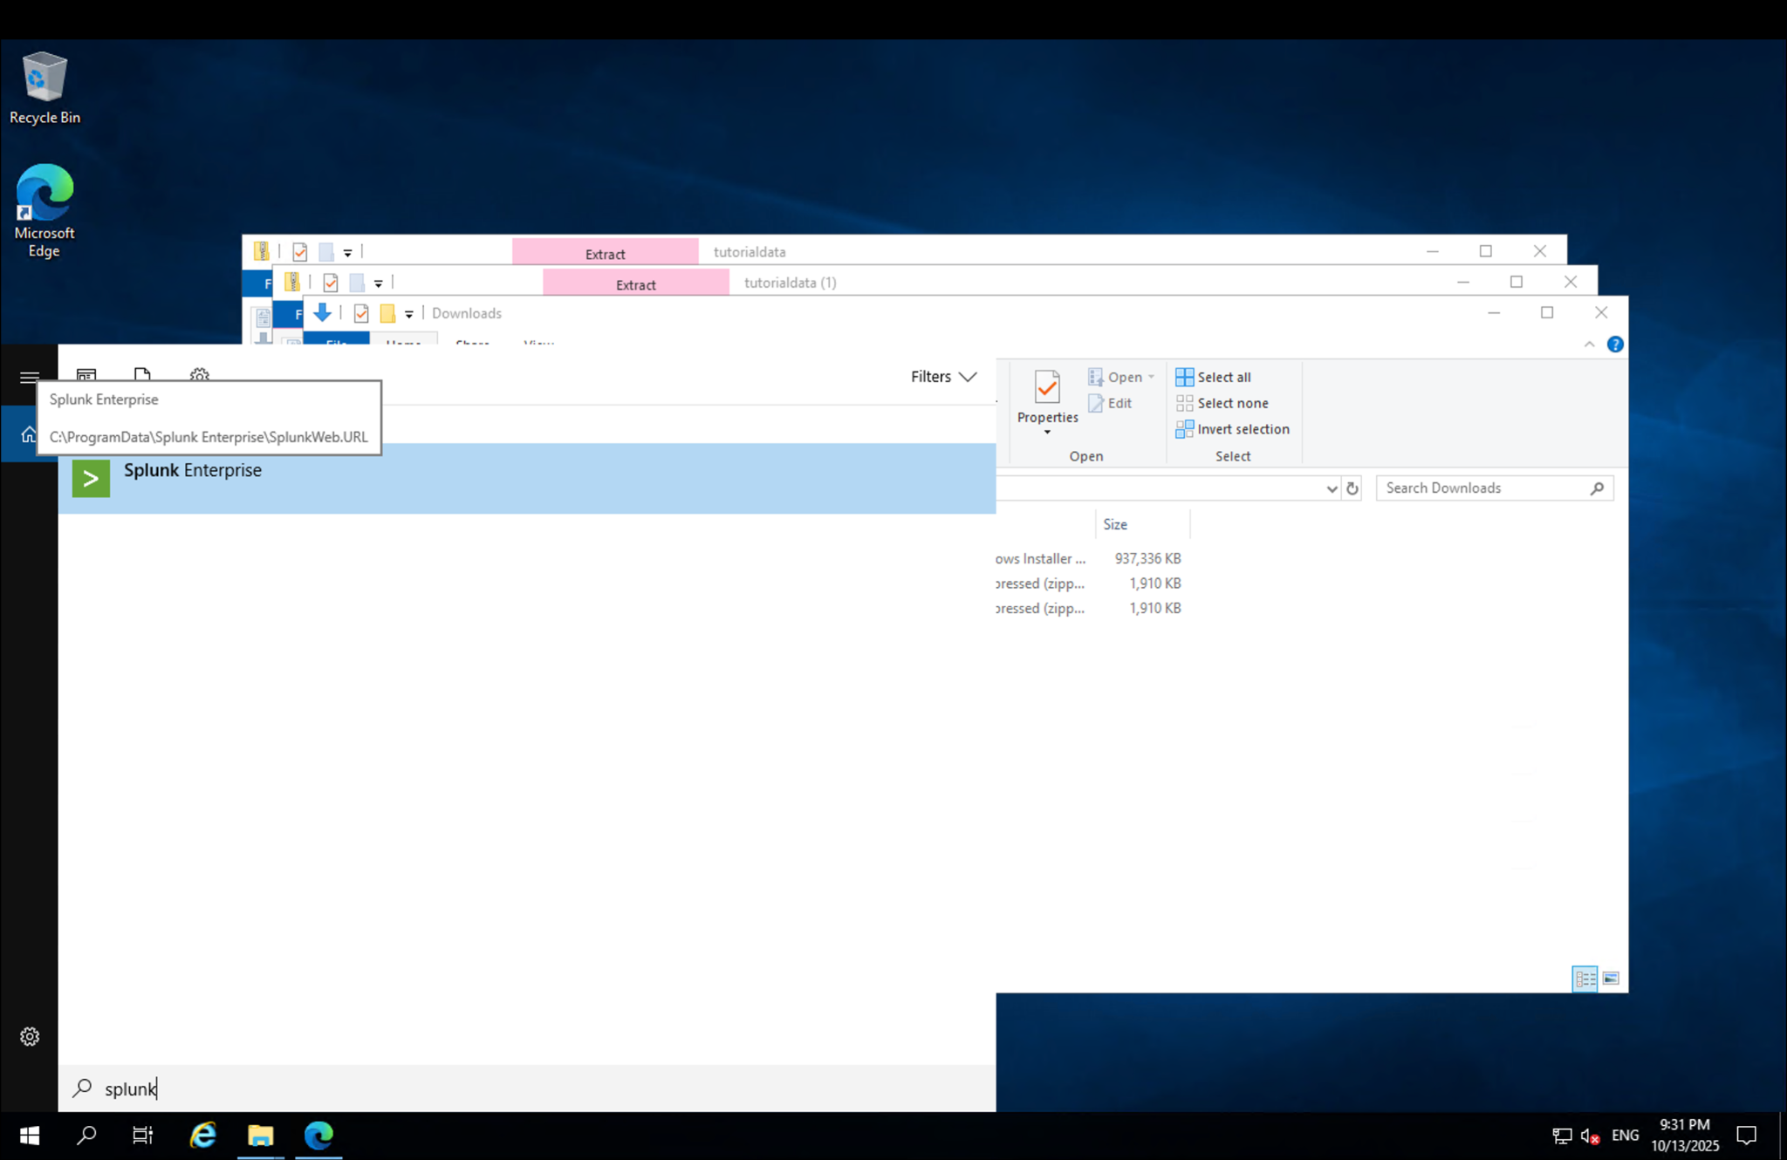

Slide 6
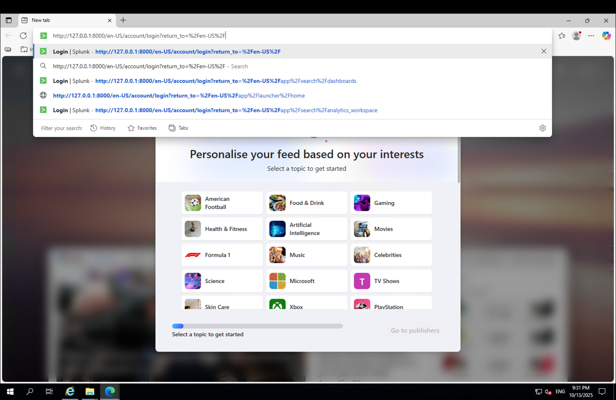

Slide 7
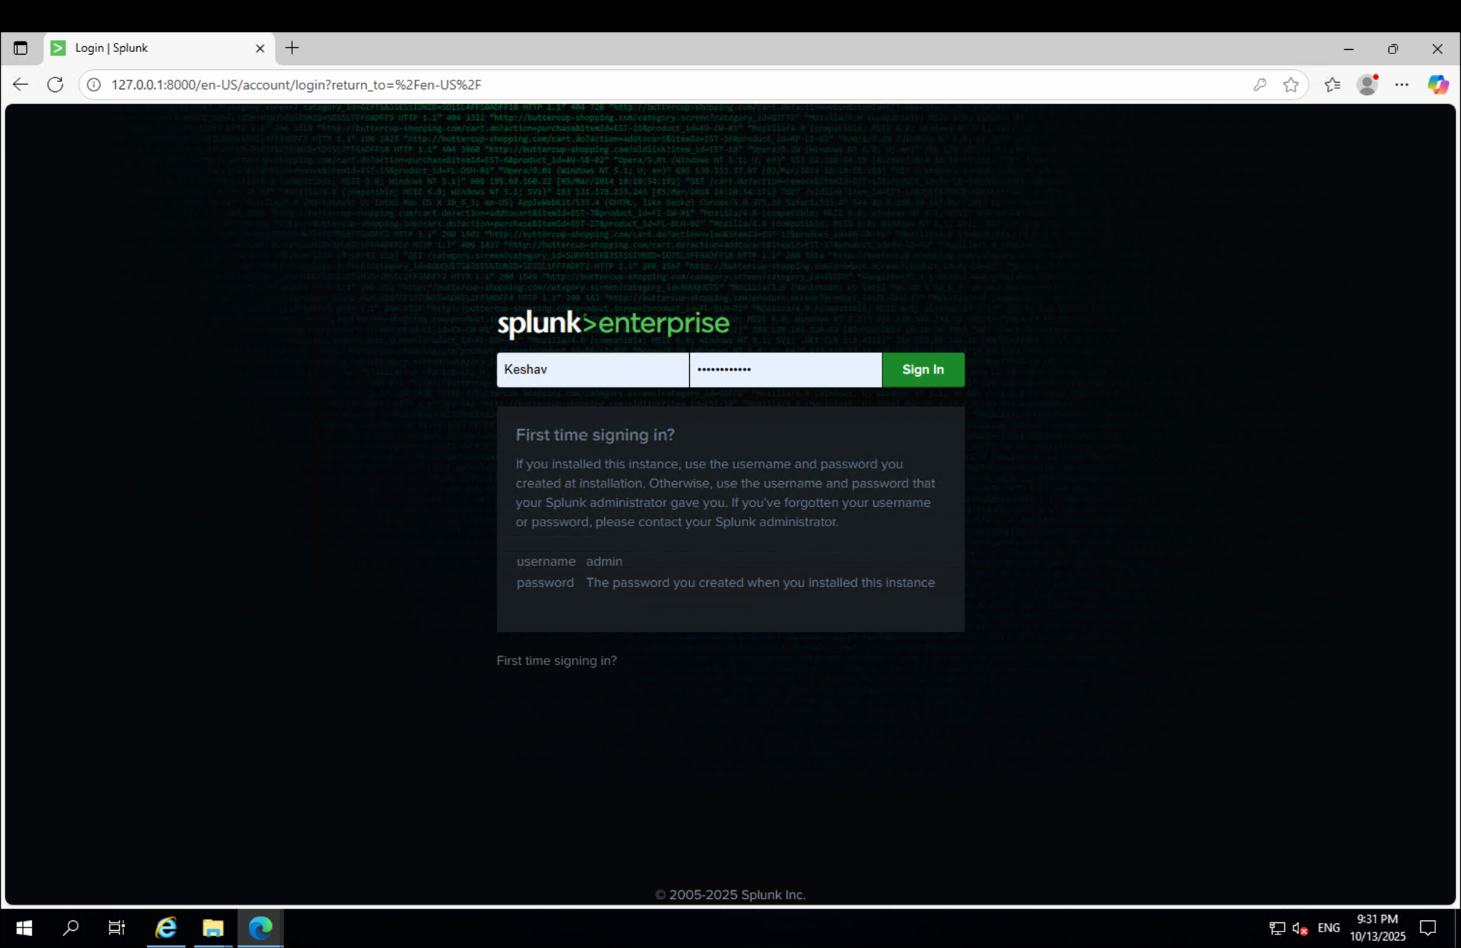

Slide 8
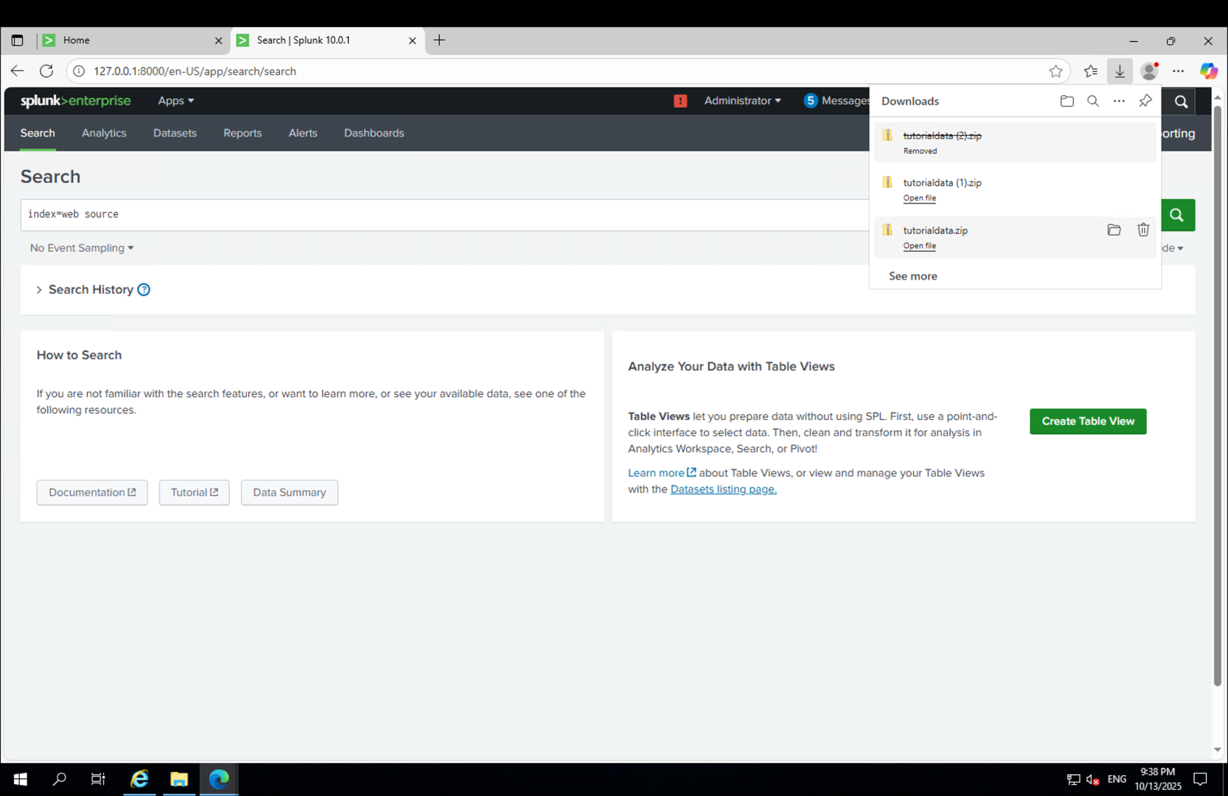

Slide 9
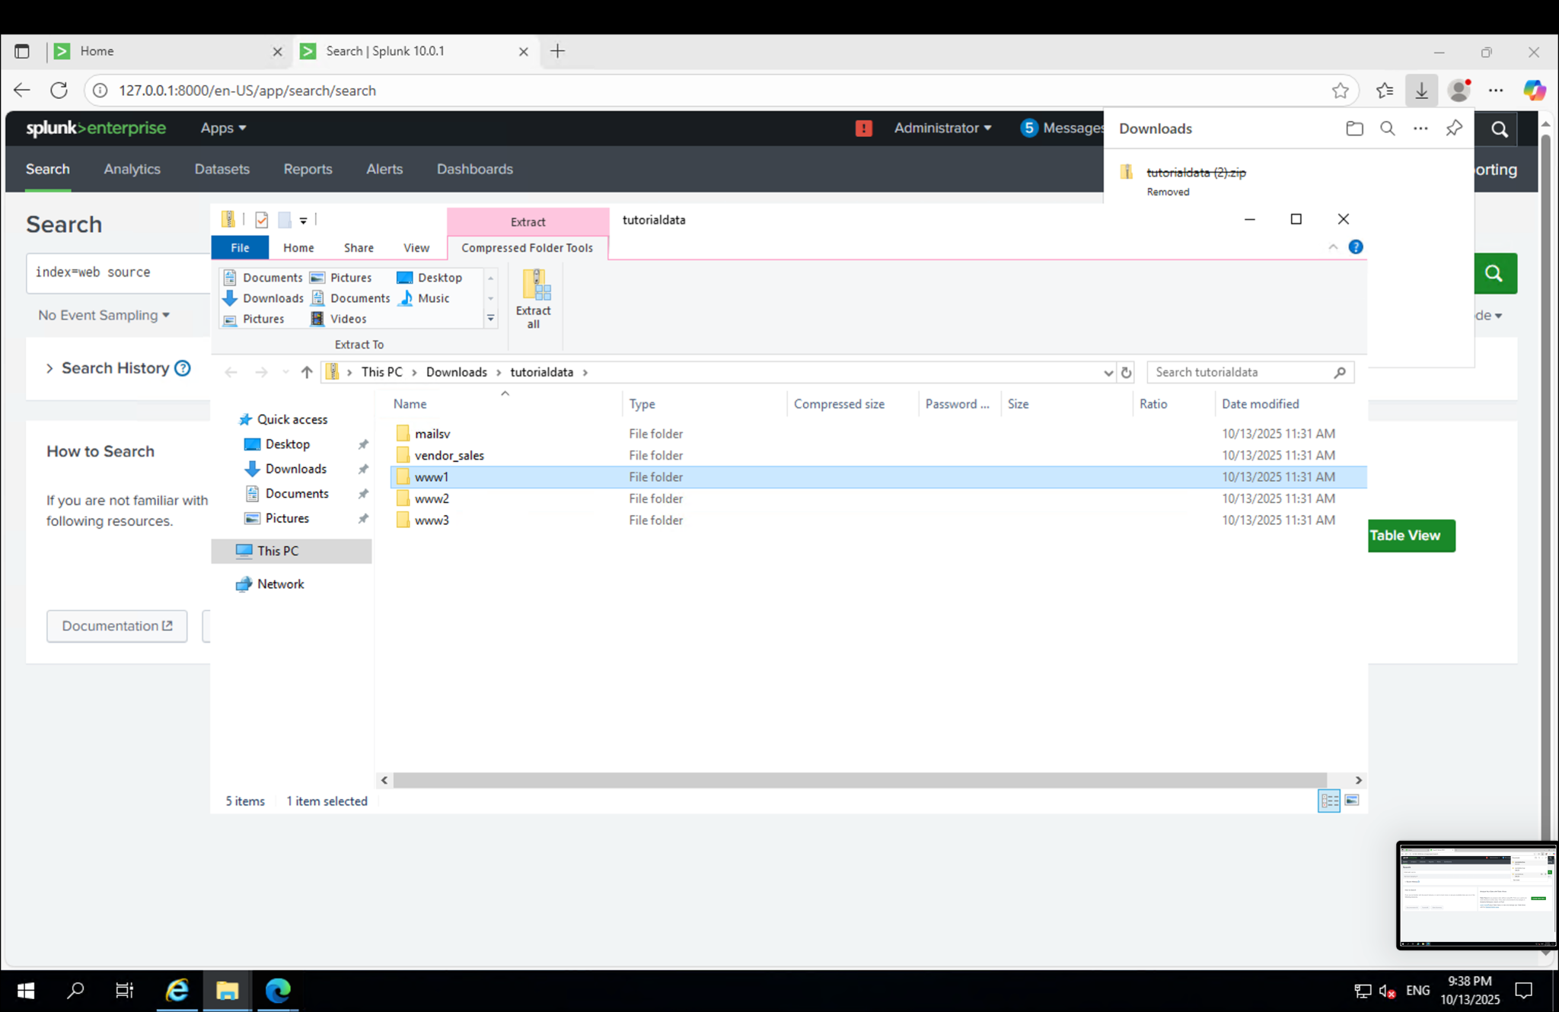

Slide 10
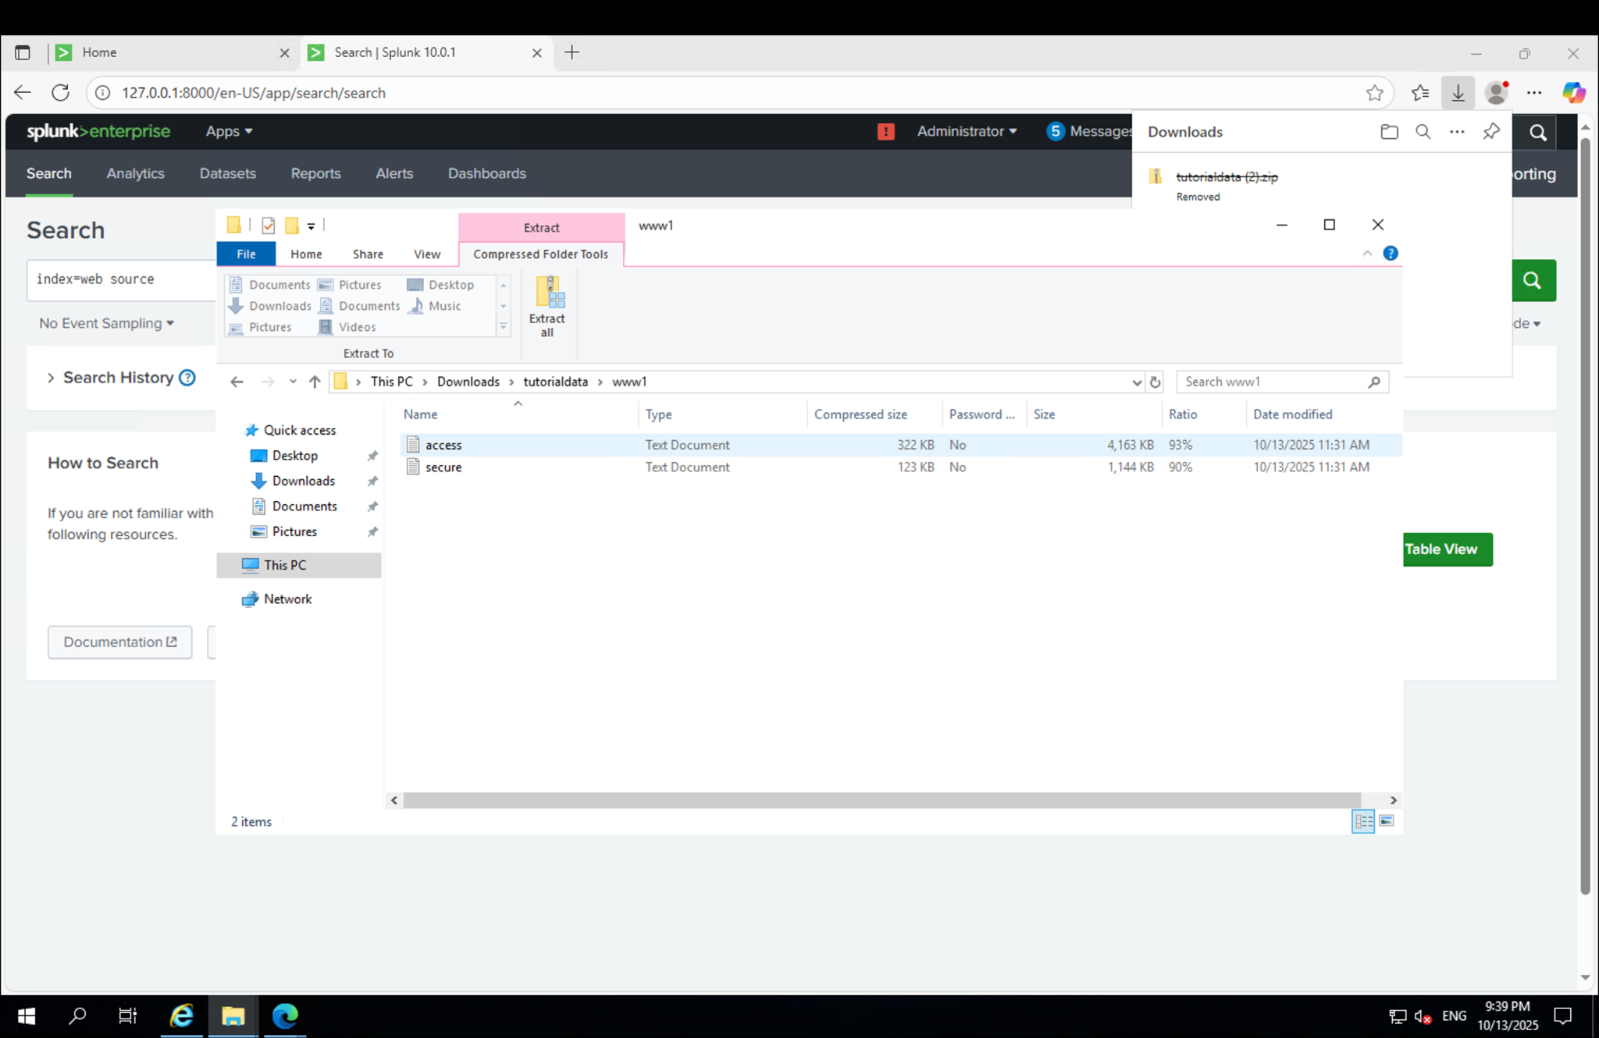

Slide 11
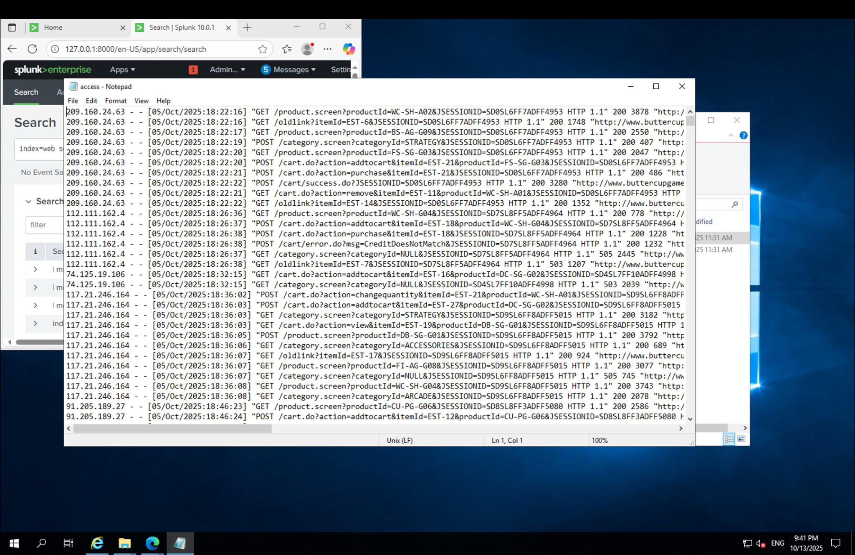

Slide 12
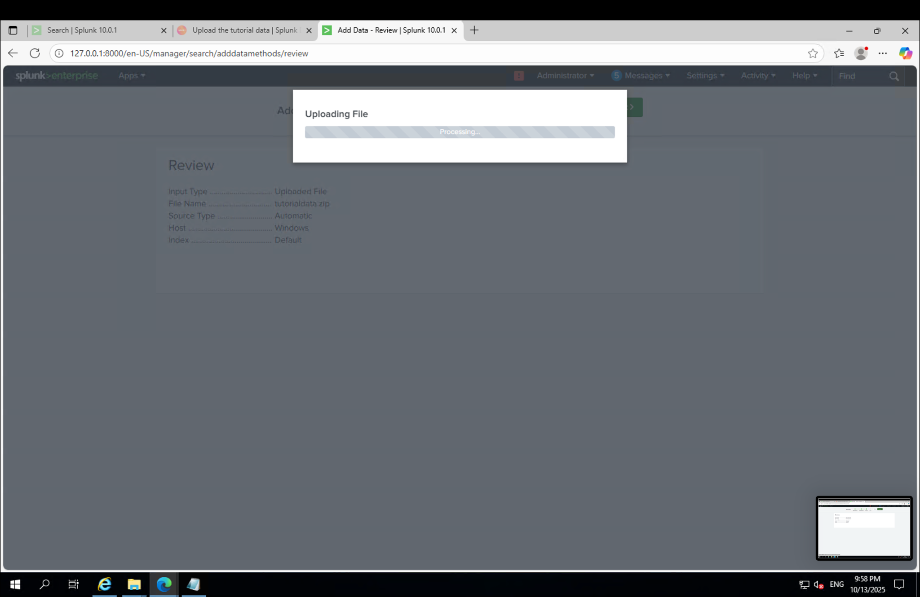

Slide 13
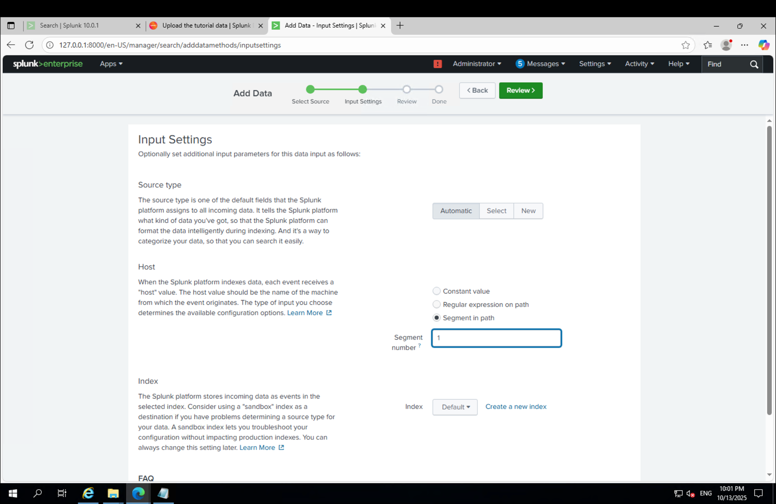

Slide 14
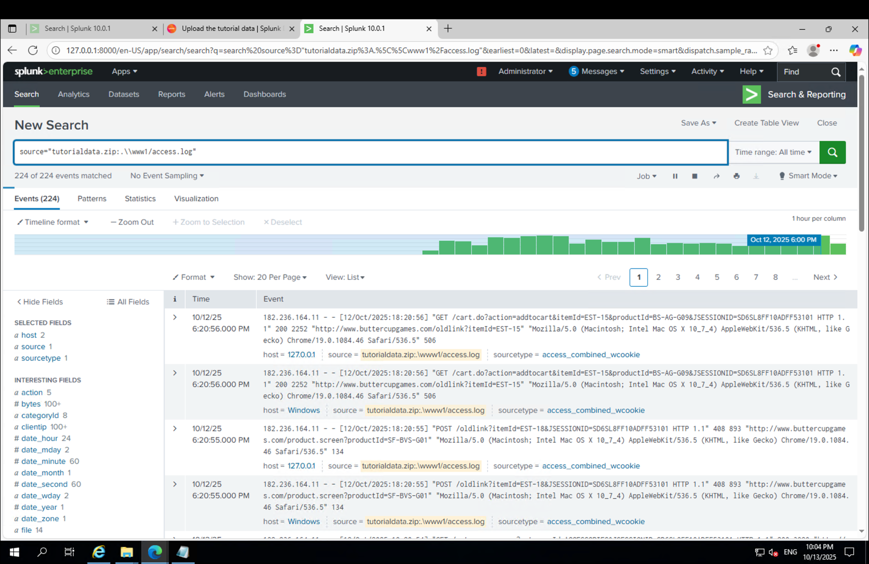

Slide 15
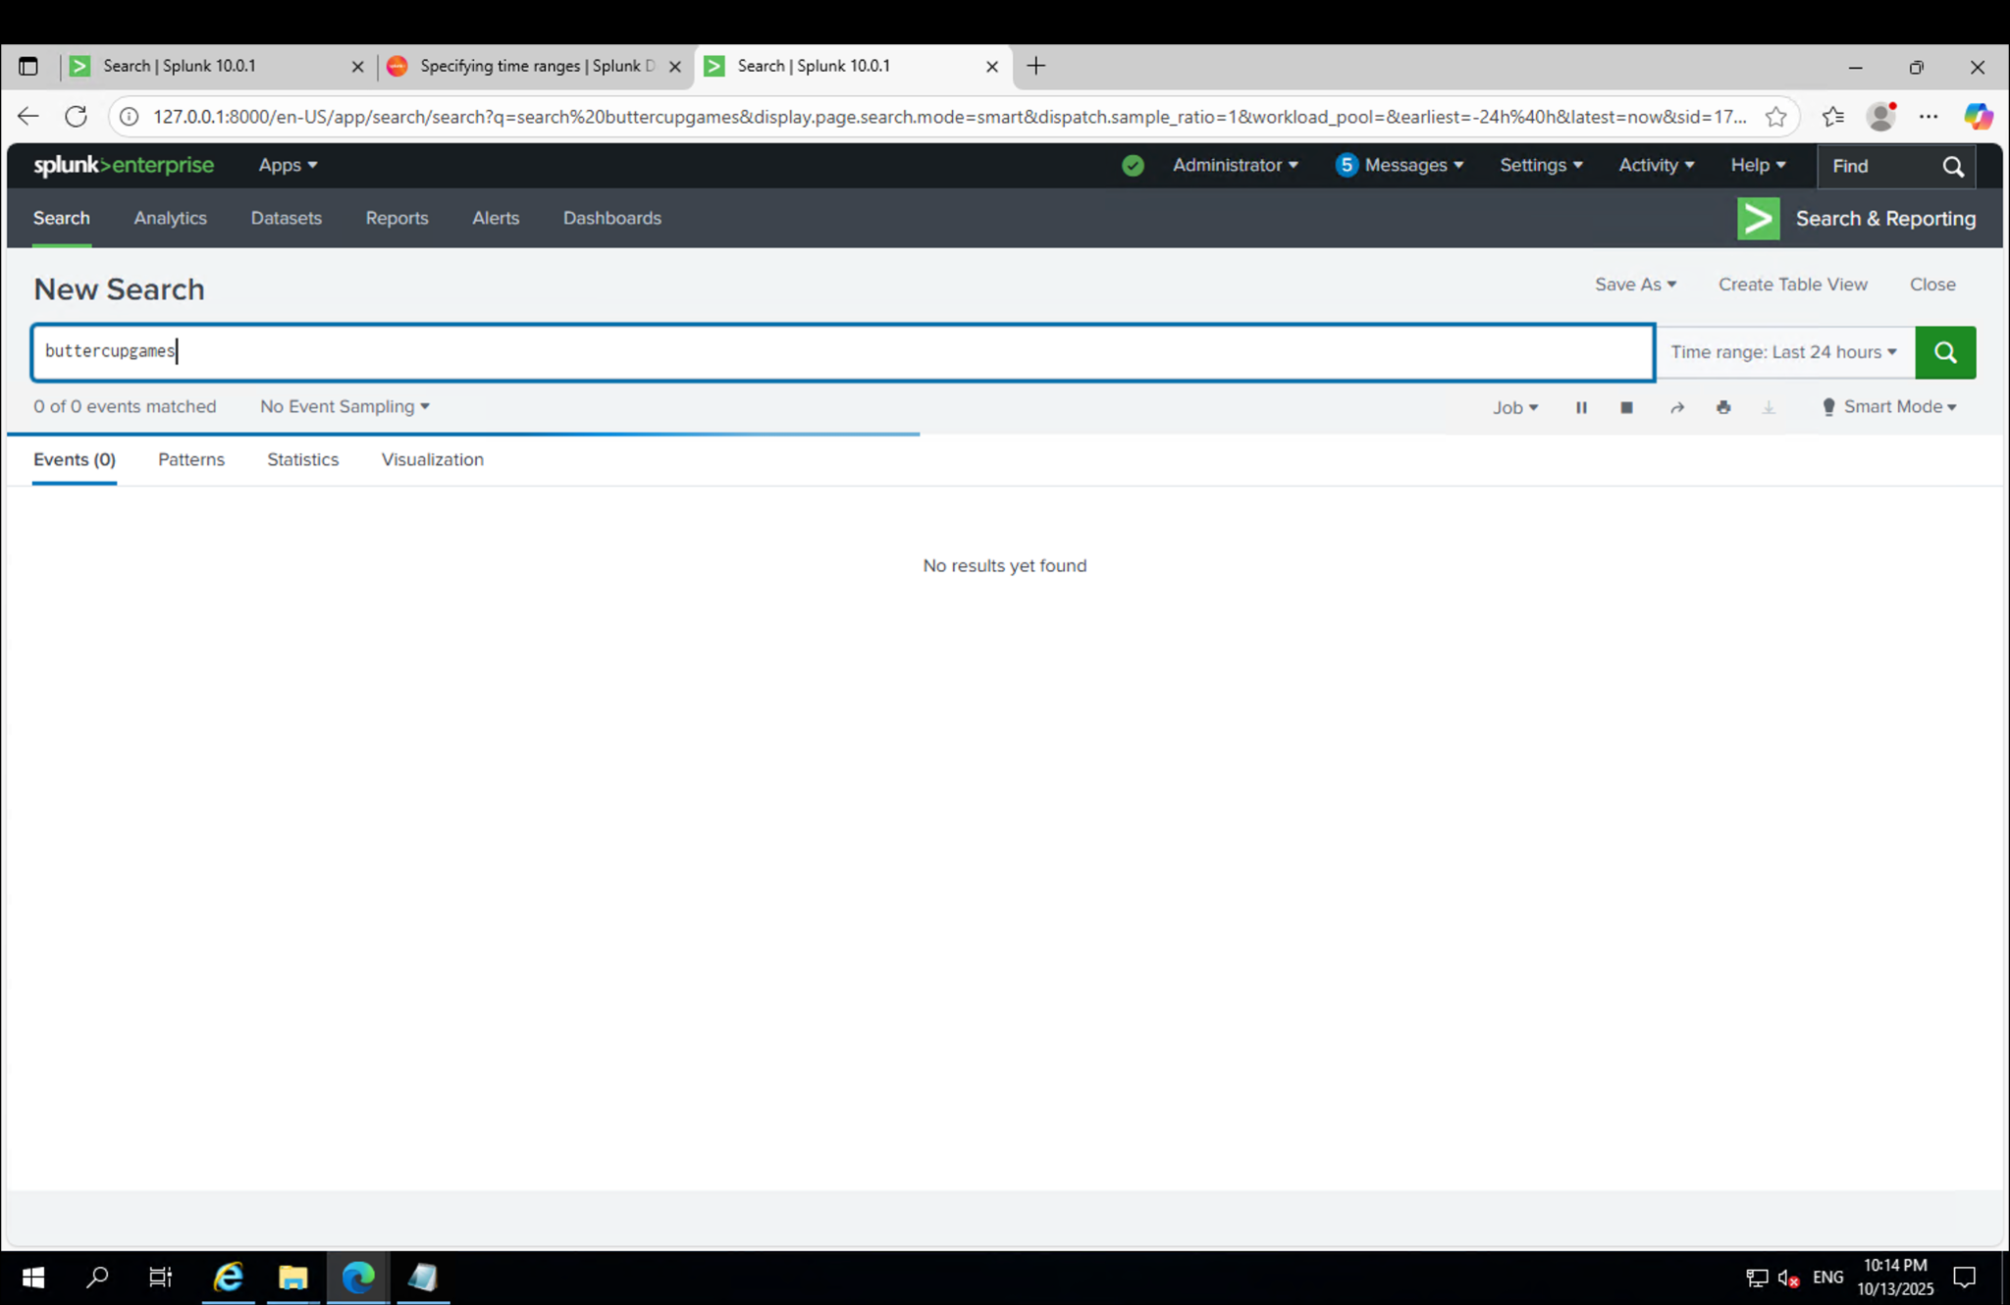

Slide 16
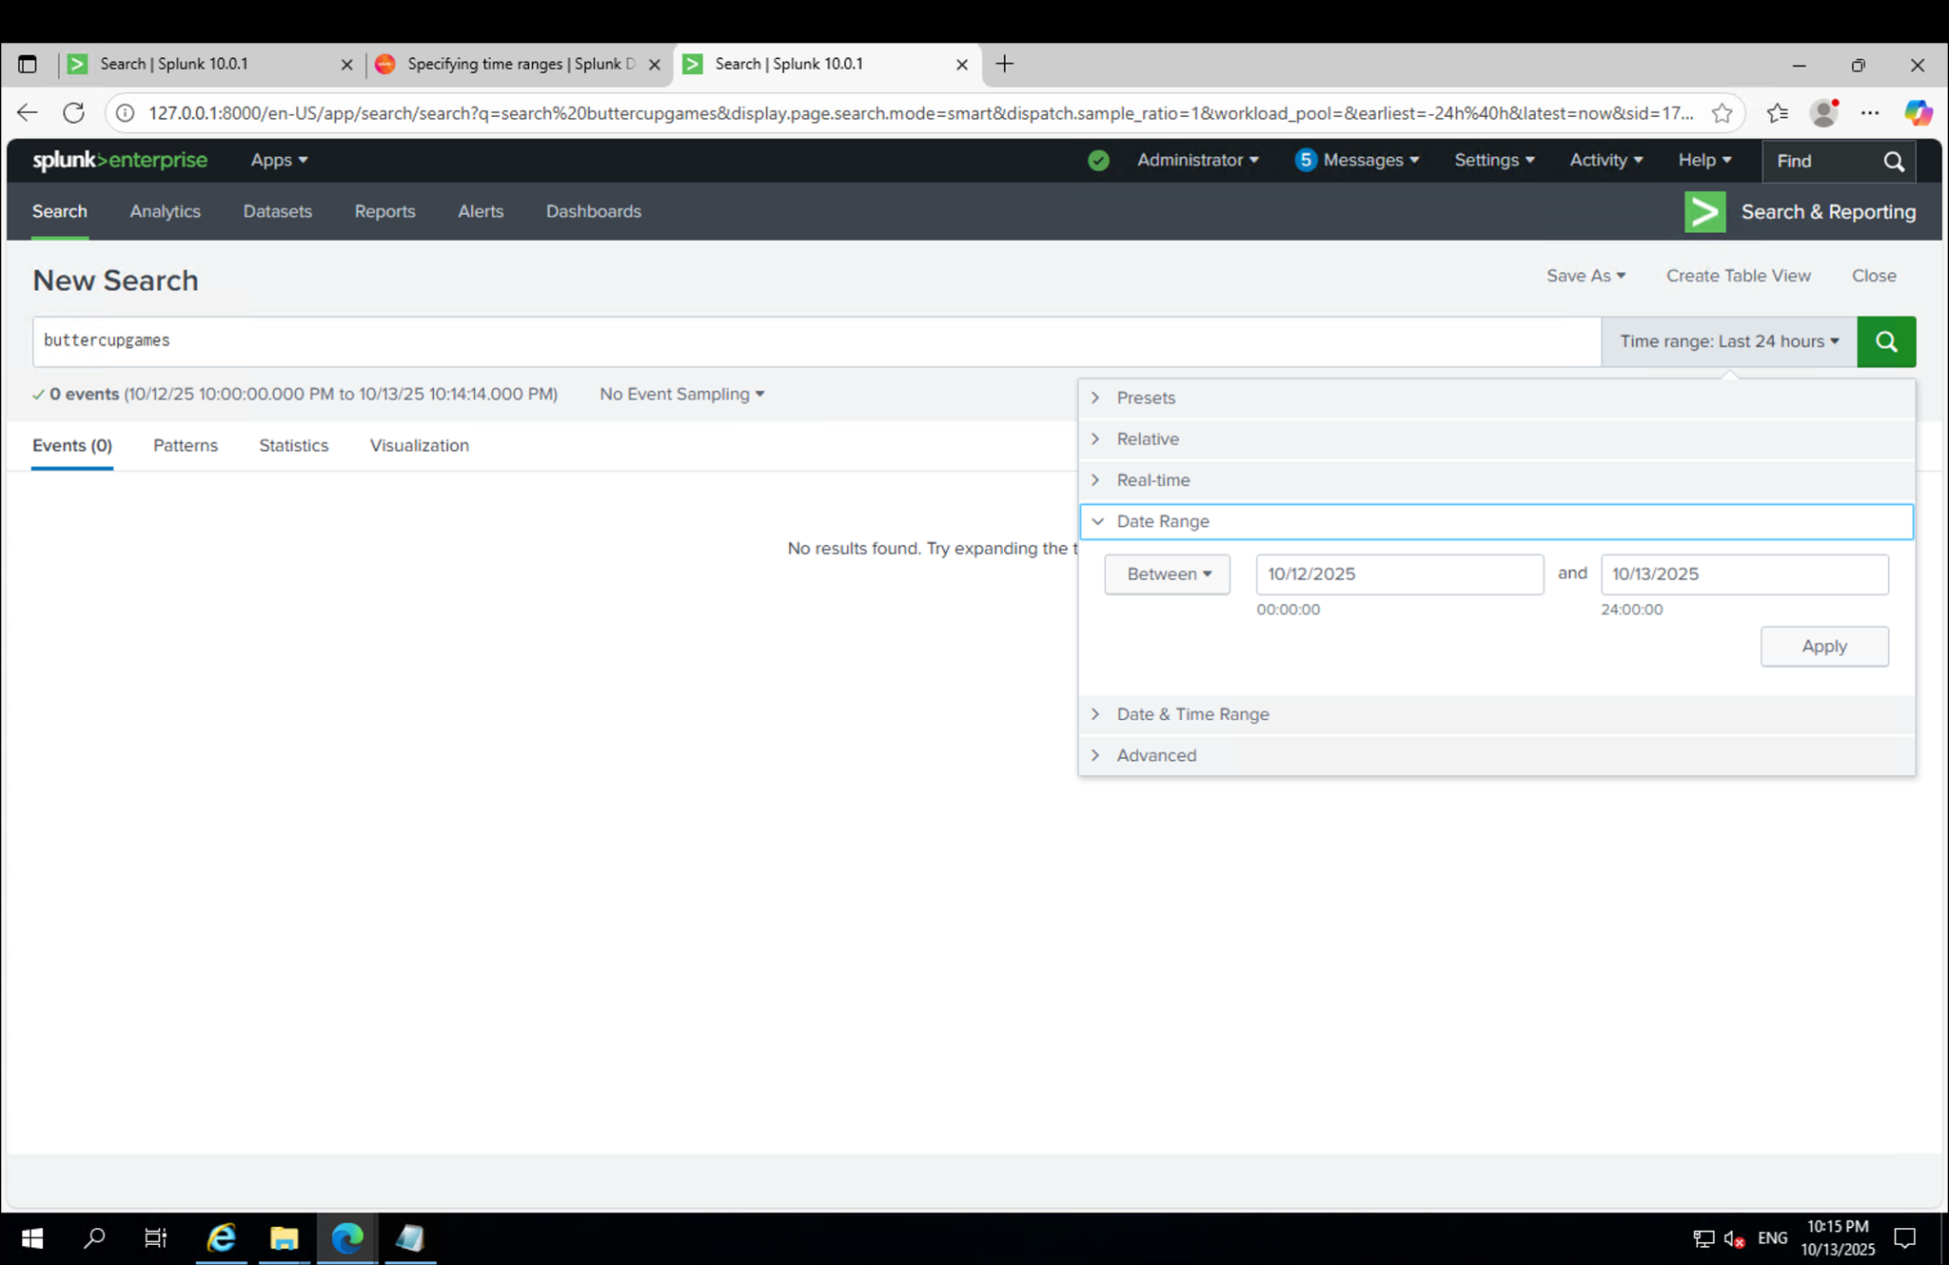

Slide 17
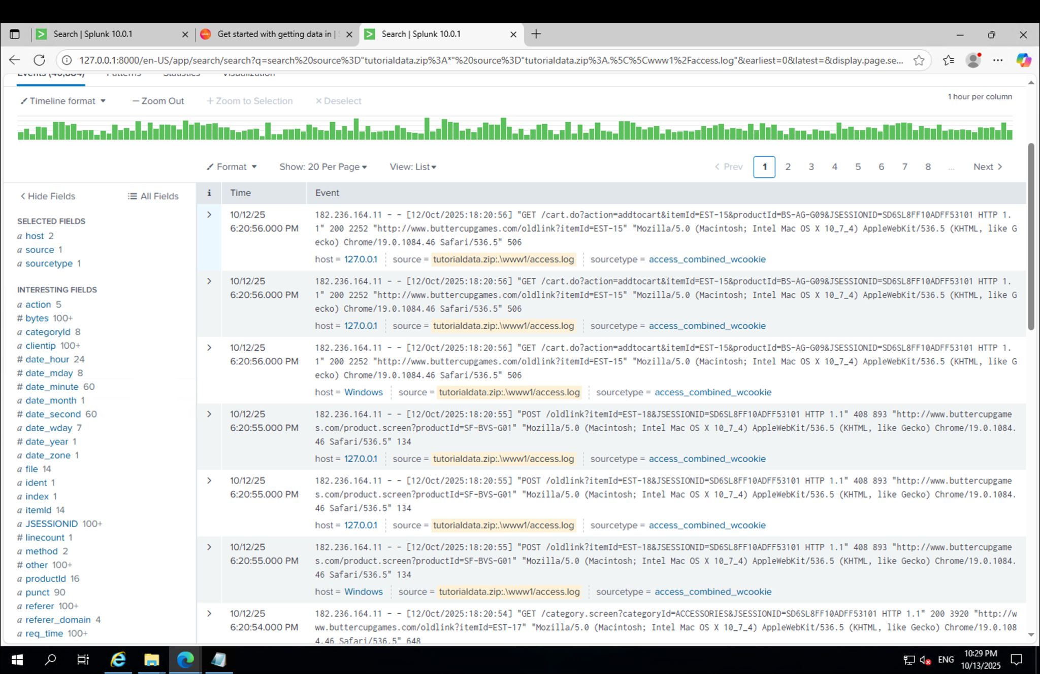

Slide 18
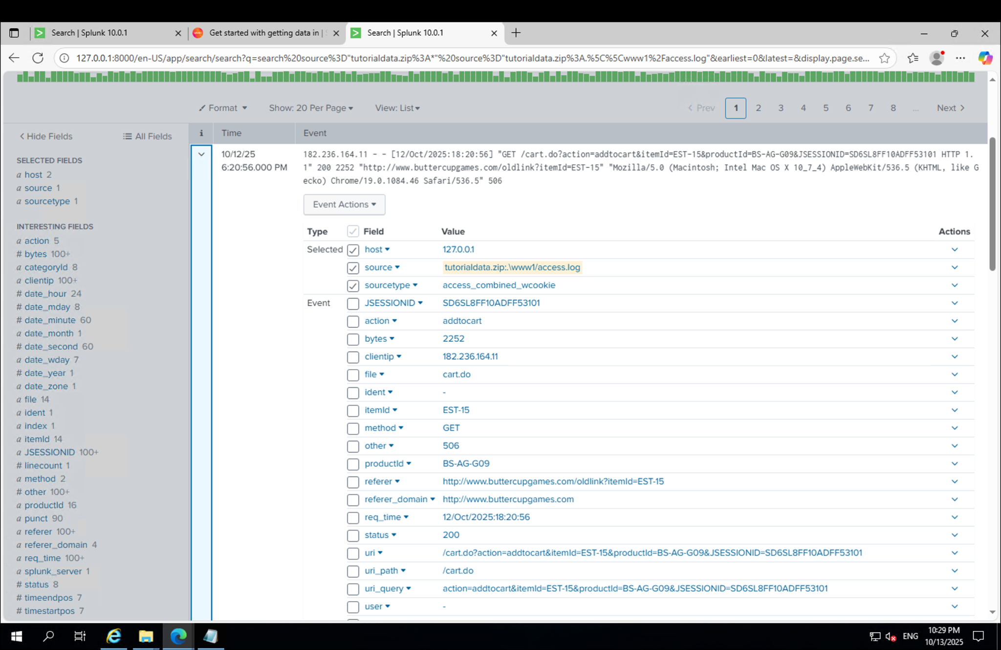

Slide 19
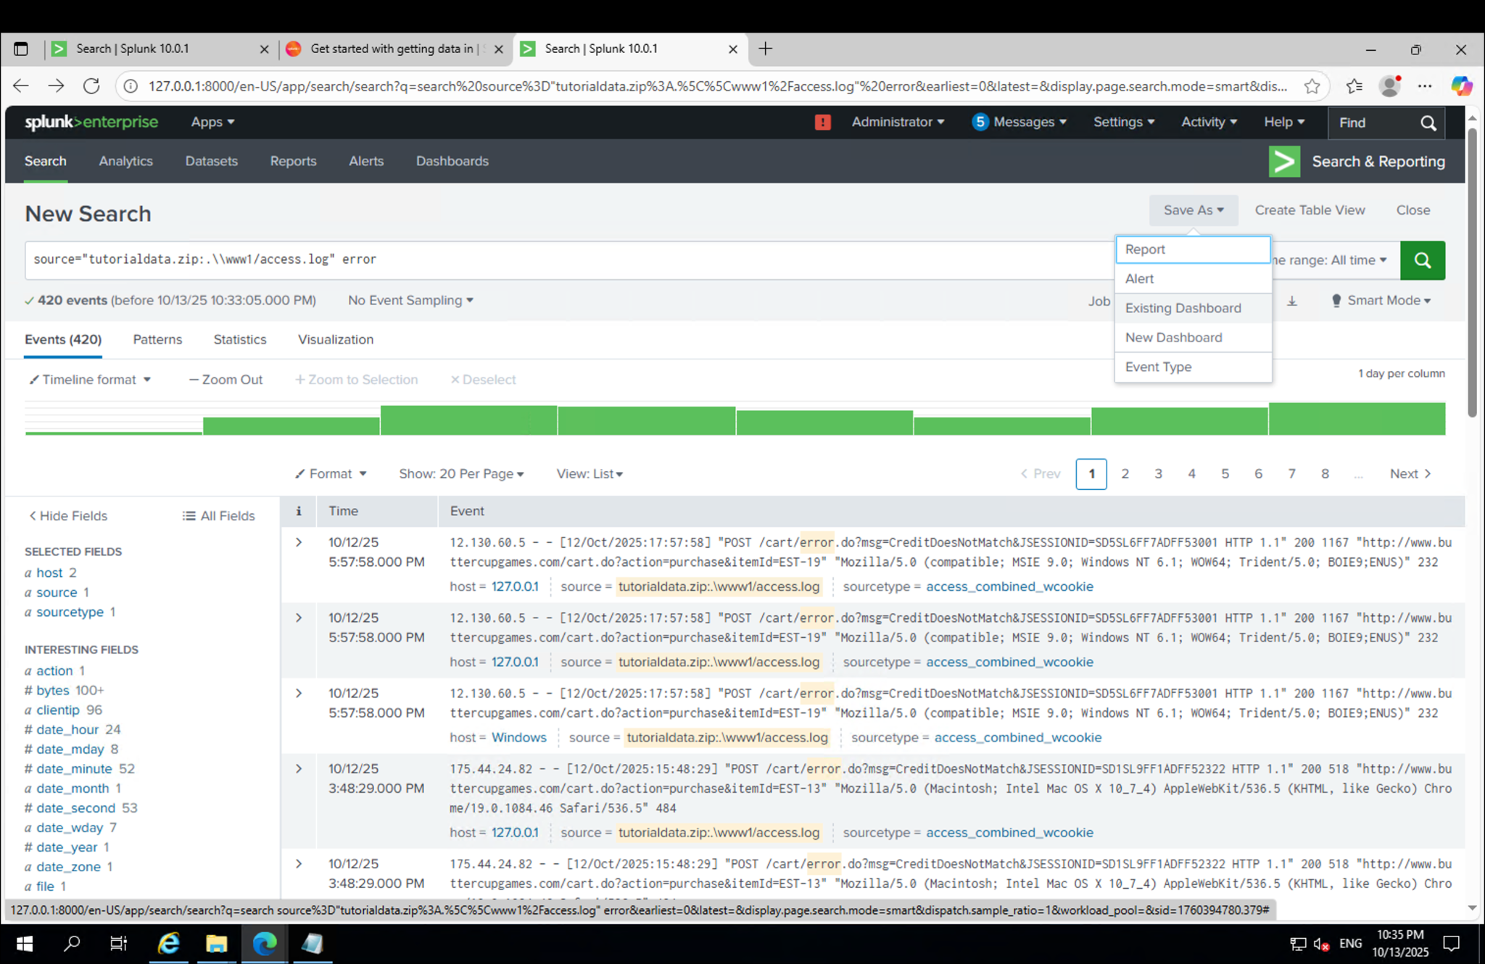

Slide 20
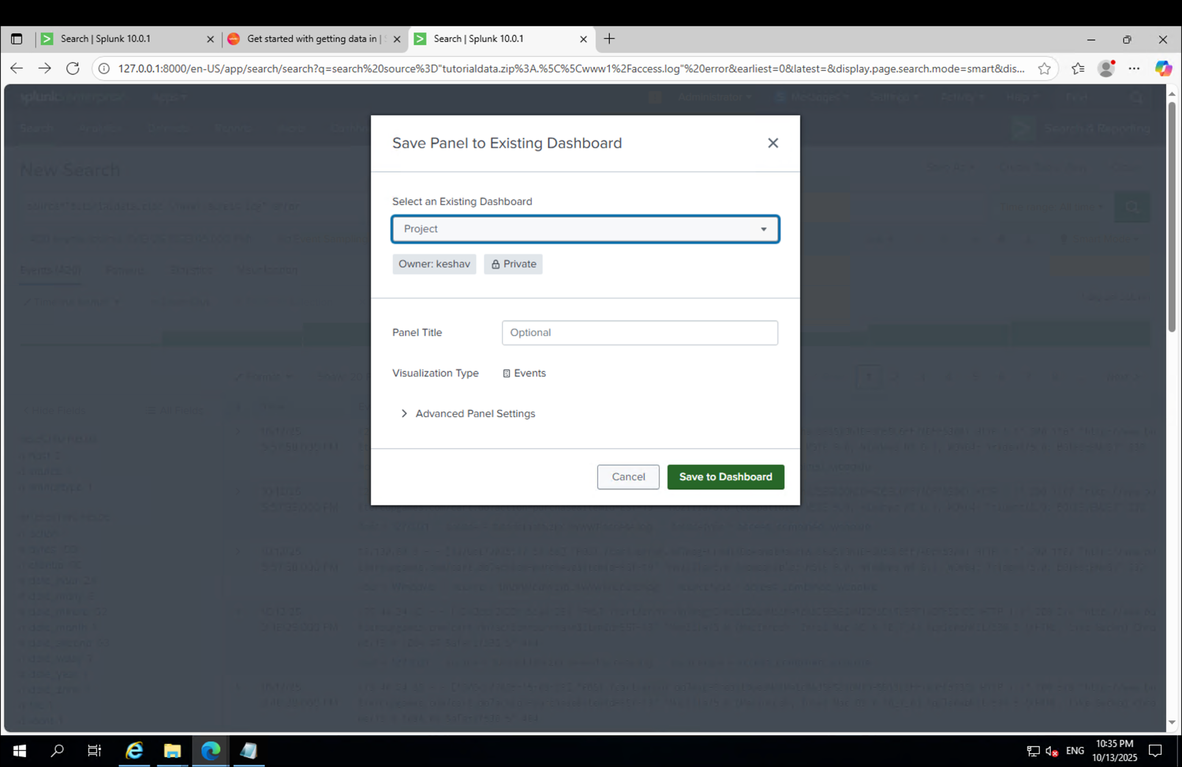

Slide 21
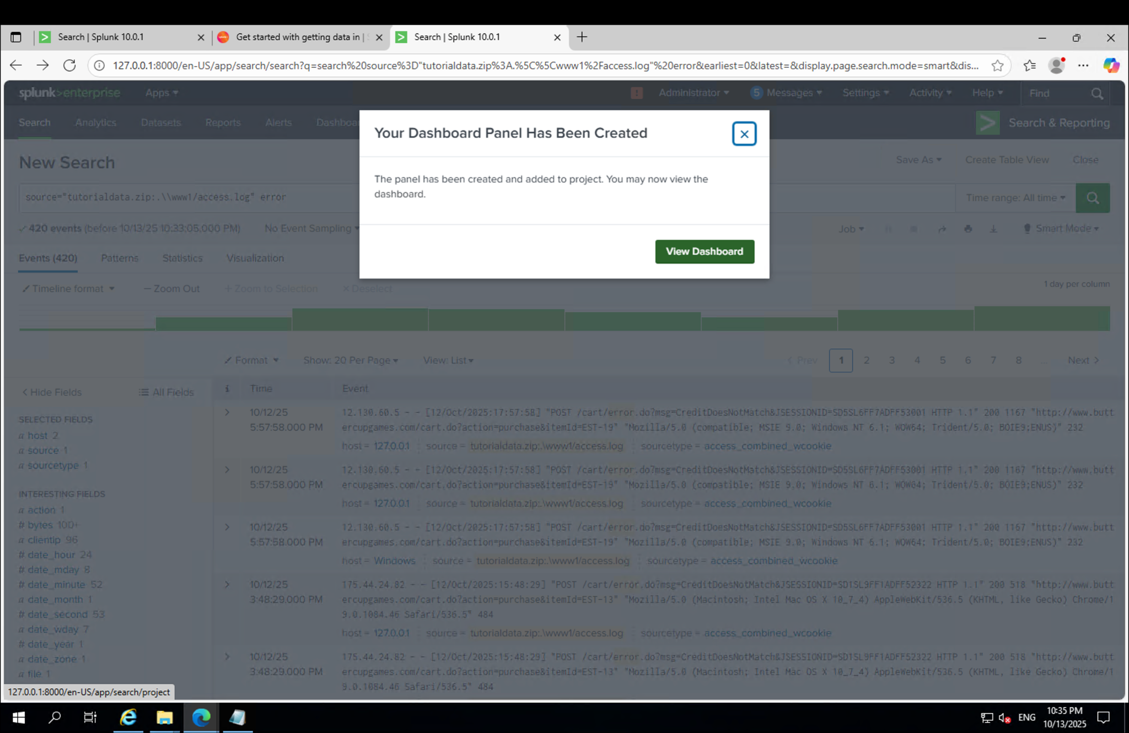

Slide 22
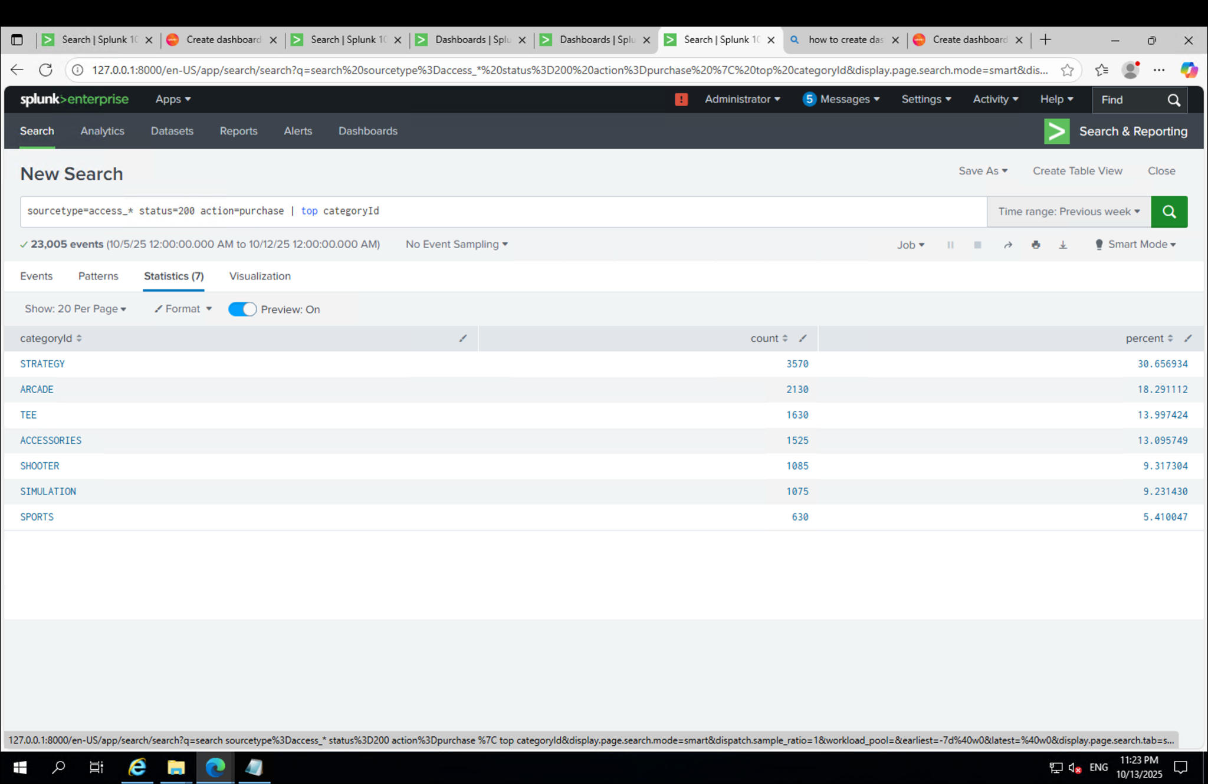

Slide 23
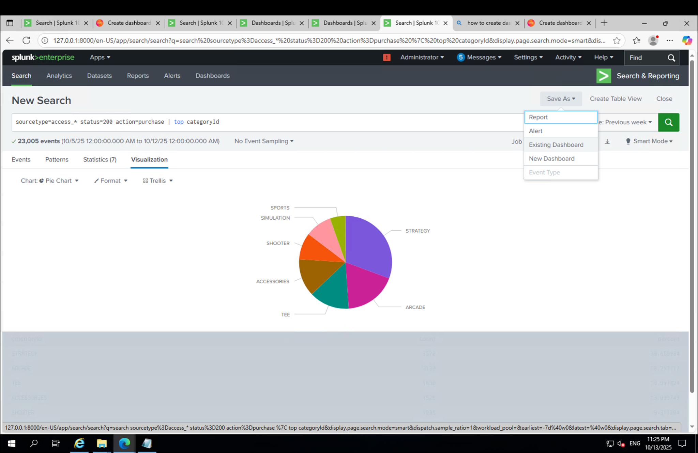

Slide 24
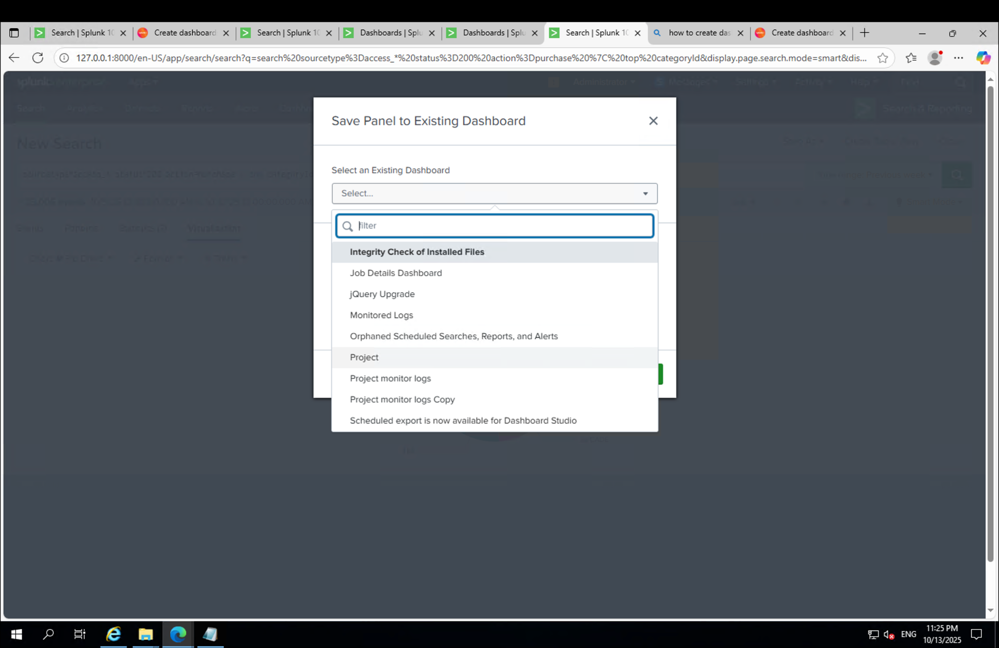

Slide 25
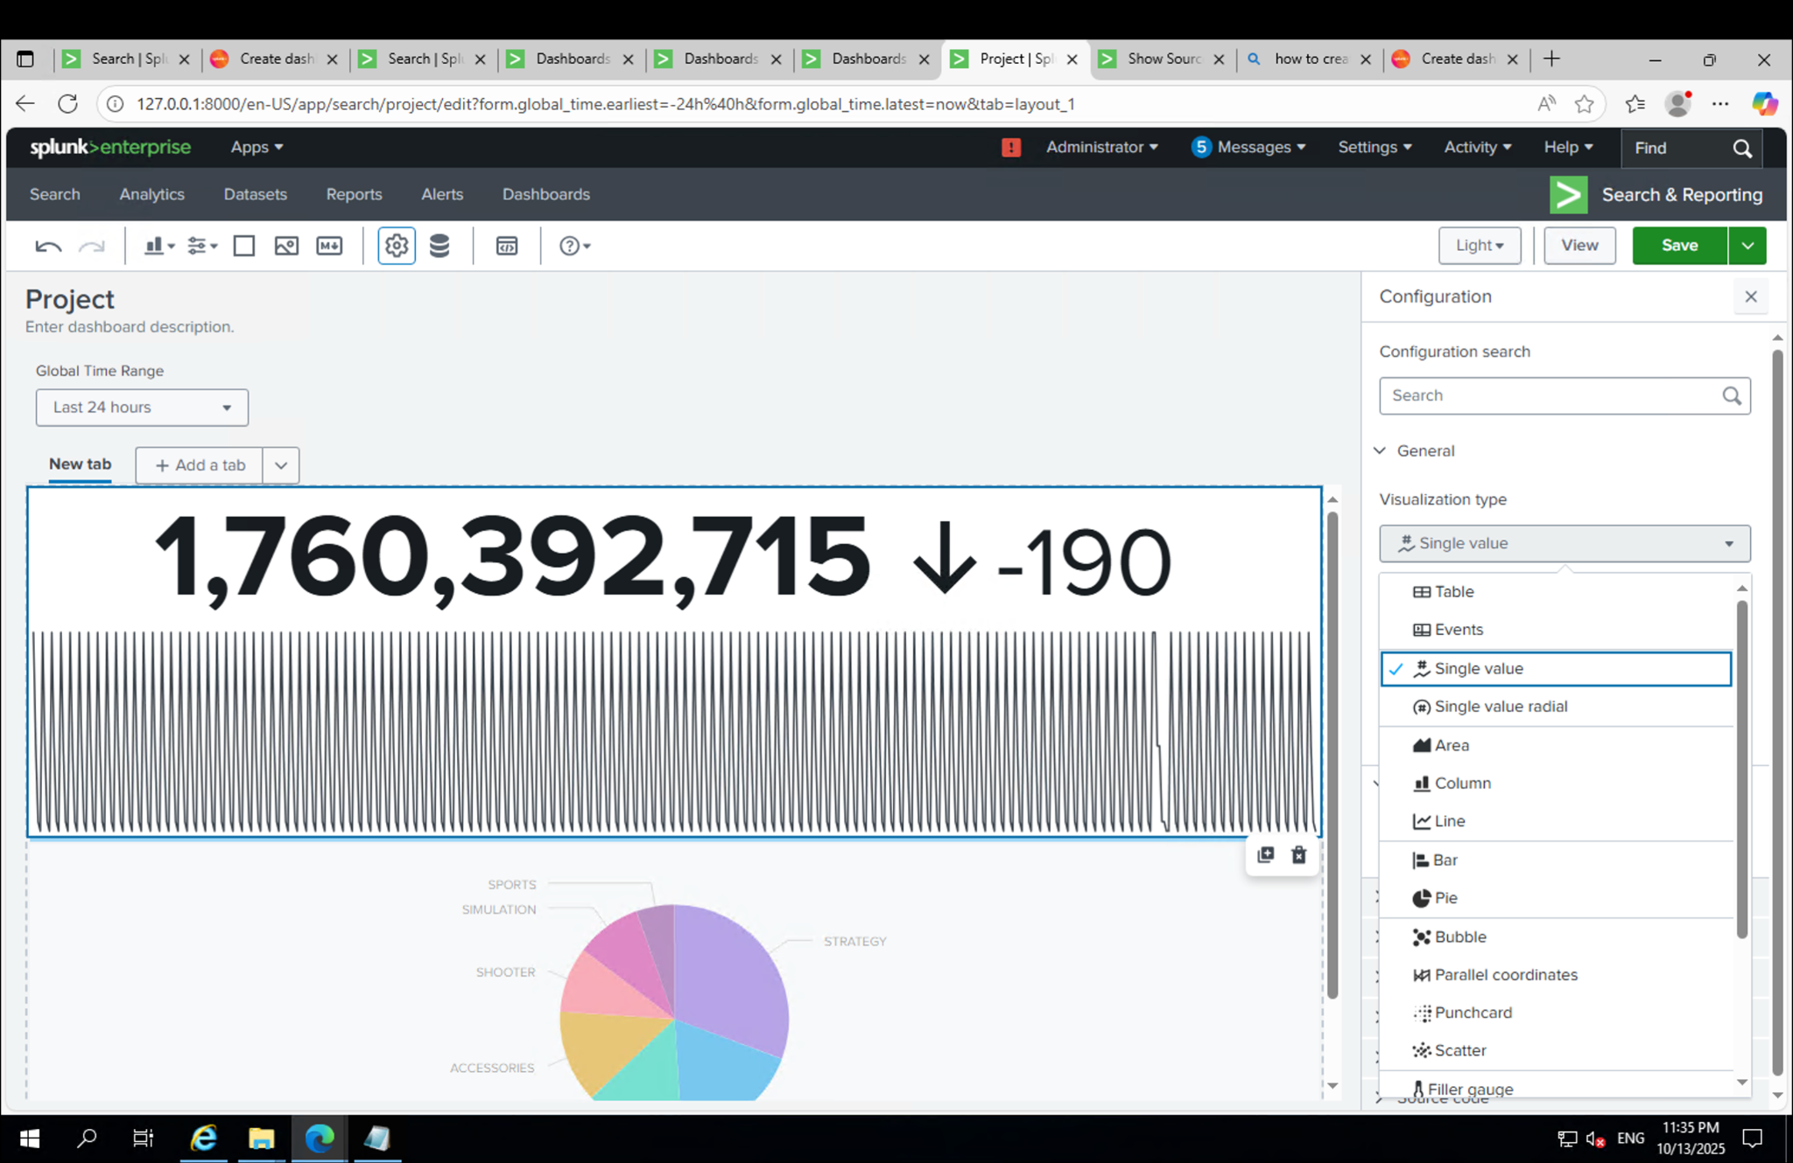

Slide 26
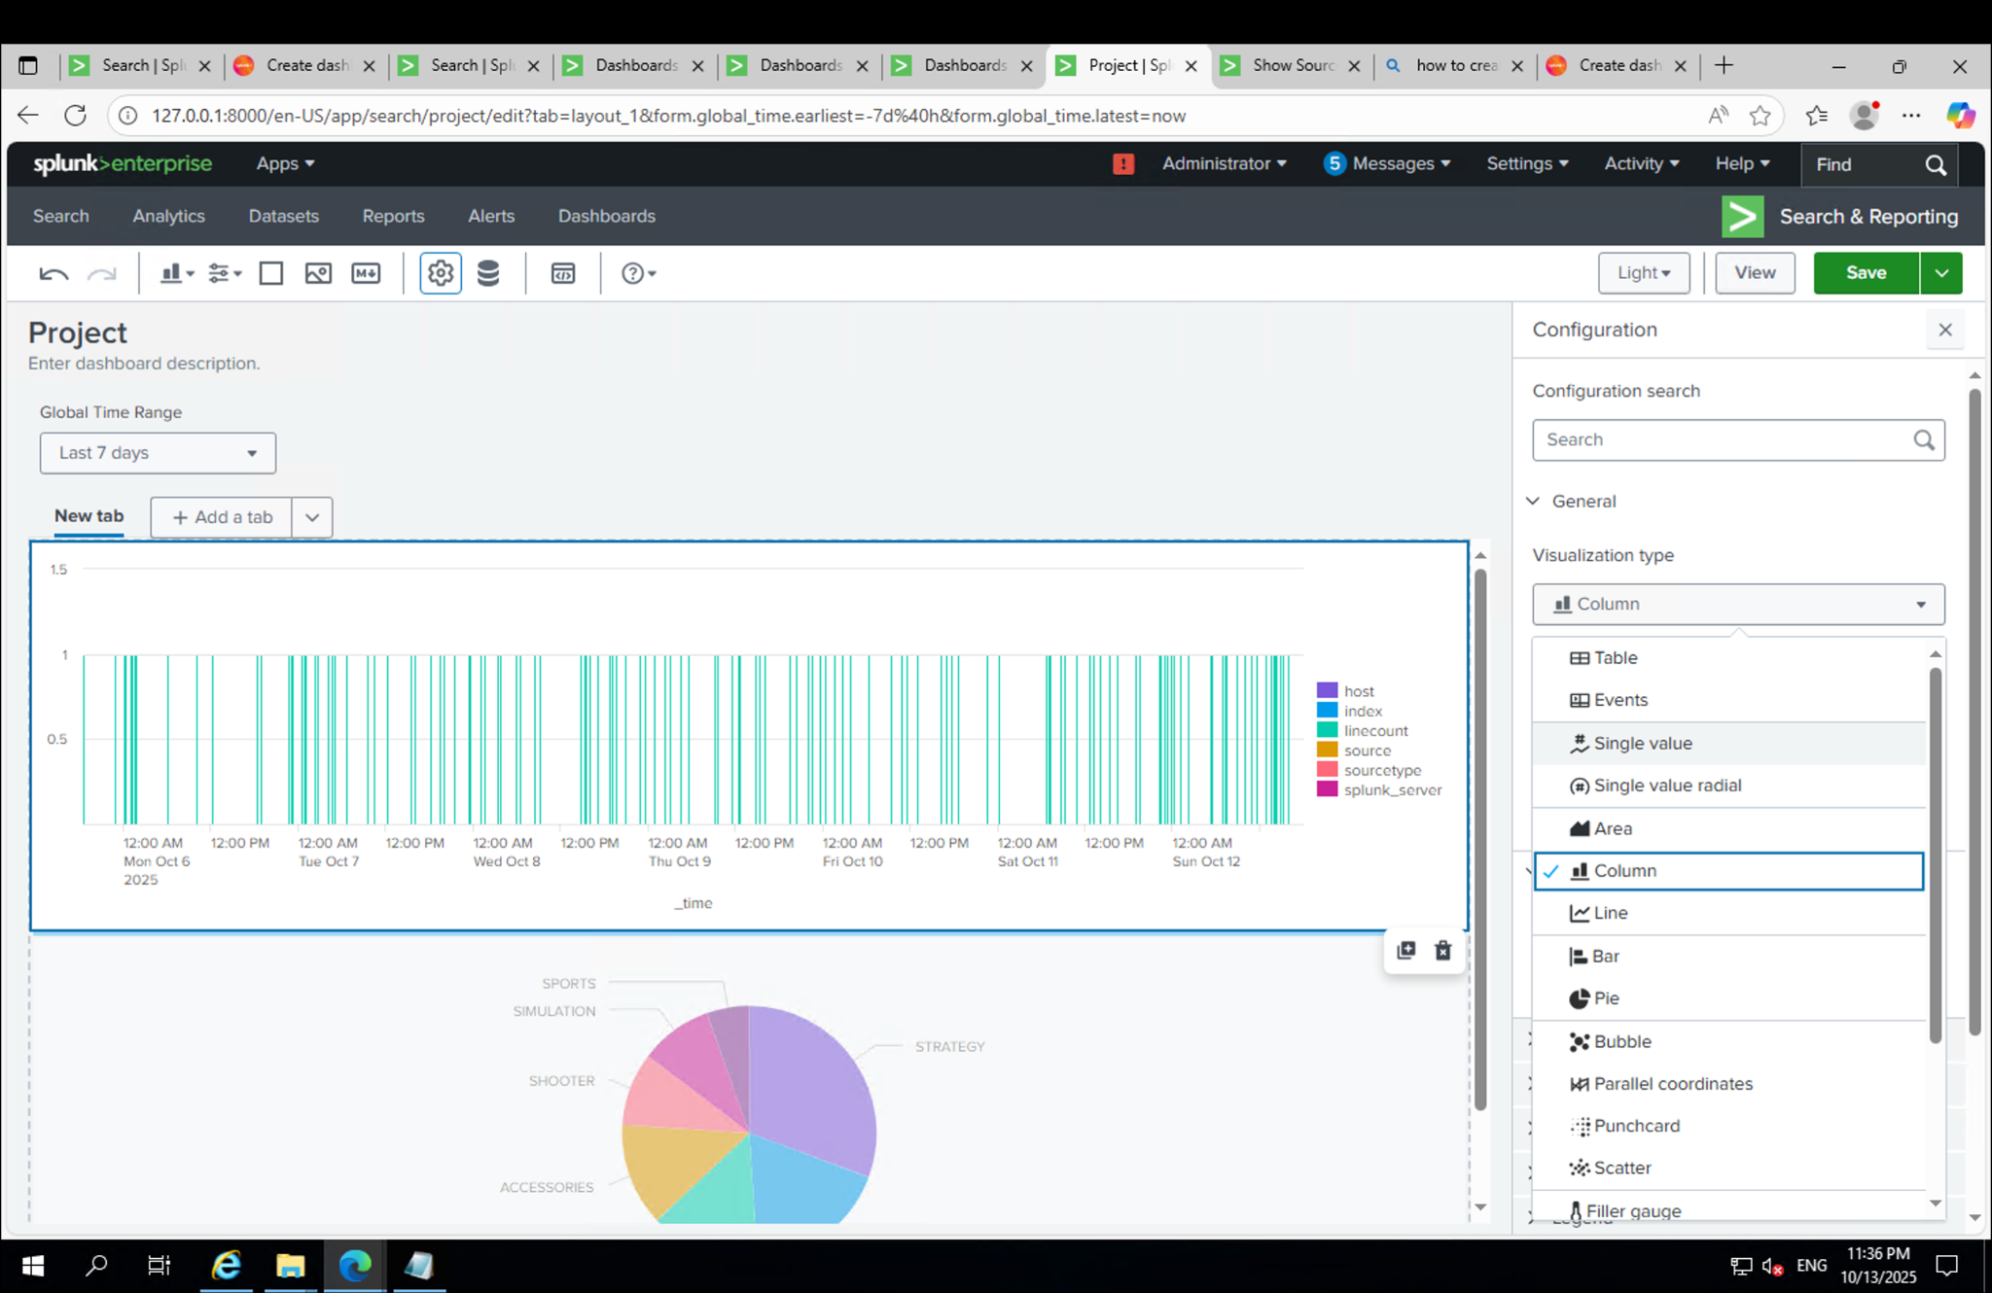

Slide 28
Findings and Lessons Learned
✅ Splunk Enterprise successfully installed and configured.
✅ Log data from tutorial dataset indexed correctly.
✅ Dashboards visualized access logs and performance data.
Key Lessons:
- Ensure Windows prerequisites before installation.
- Splunk Web (localhost:8000) is intuitive for management.
- Custom indexes help organize log data efficiently.
- Visualization tools enhance log monitoring and insights.

Slide 29
Summary and Next Steps
Summary:
Splunk was successfully deployed, configured, and tested with sample logs.
Dashboards were built to analyze and monitor log activities.
Next Steps:
- Add real-time data monitoring.
- Explore alerting and scheduled reporting.
- Integrate with external data sources for advanced analytics.

